Slide 1
Online game server on Akka.NET
Esun Kim
veblush@gmail | github/veblush

Slide 2
Agenda
Introduction
Why Akka.NET ?
Introduction to Akka.NET
Addition to Akka.NET
Real-time online Tic-tac-toe
Conclusion

Slide 3
Introduction
Why and what did I do?

Slide 4
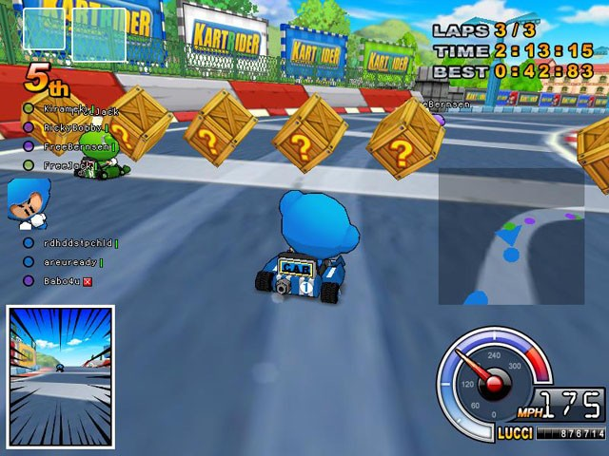
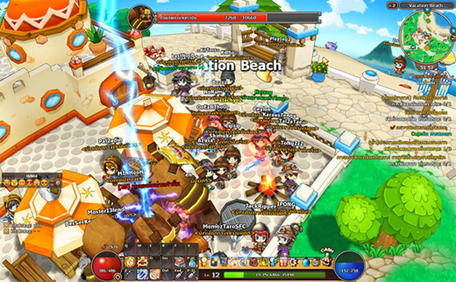
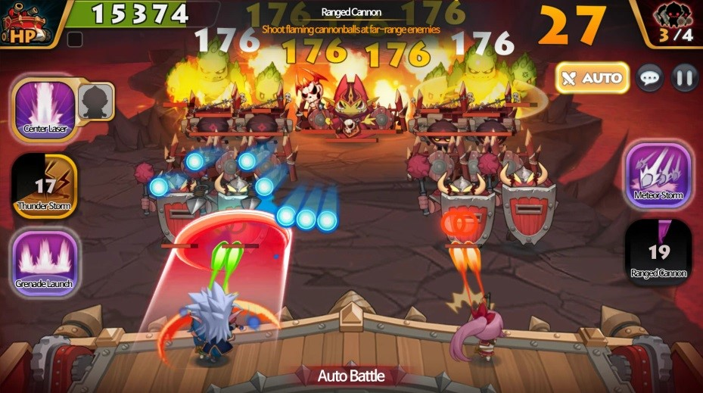
Previous game servers
KartRider (2004)
Everplanet (2010)
MonsterSweeperz (2015)
P2P game Server
C++ / IOCP socket
MMORPG server
C++ / IOCP socket
Mobile game server
C# / IOCP socket

Slide 5
Development Process
Small team
No dedicated server dev.
Everyone does everything.
Client is developed first and server will be followed.
e.g. Server of KartRider was built just before 3rd closed-beta test.

Slide 6
Development Process
Rapid development: Good and Bad
2-4 weeks working days for building server architecture.
Only meets minimum requirements.
Agile and no wastes.
But hits the architectural limitation soon.
a few years after launch?
Very hard to revamp core design of server in live service.
It’s better to have more general and flexible library for creating new game contents that has never been considered.

Slide 7
Research
Invest time for getting flexible tools
12 weeks
Includes research and building demo games.
Research
Akka.NET, Orleans and more
Building demo app and game
Chatty, Tic-tac-toe and Snake
These tools will be used for making next game.

Slide 8
Why Akka.NET ?
What is Akka.NET?

Slide 9
Akka.NET ?
A toolkit providing actor-base concurrency on the JVM.
Akka.NET is a port of the Akka to .NET.

Slide 10
Why actor model?
Actor
State
Stateful online game objects
User, Character, World, and so on.
Real-time interaction between objects.
Actor is good to deal with many stateful objects.
Already adopted and used widely in the game industry.
M3
M2
M1
Behavior

Slide 11
Why actor model?
UserActor
_count
// actor.receiver
UserActor.OnChat(Chat m) {
_count += 1;
Print(m.Message);
}
// sender
GetUserActor().Send(
new Chat { Message = "Hello?" });
M3
M2
M1
OnChat

Slide 12
Why .NET?
To make client and server use same language
Client is built with Unity3D and written with C# on .NET.
Client and server can share domain code.
No context switch cost for developing both at the same time.
Good platform
Good performance :)
Can target multiple platforms with .NET Core.
Can use Linux without worrying about subtle difference between Mono and .NET.

Slide 13
Why Akka.NET ?
Considerations to choose one
Should be an active open source project.
Should be stable enough to be used right now.
Should be not hard to support .NET 3.5.
Unity3D still relies on .NET 3.5.
Candidates
In-house library
Orleans http://dotnet.github.io/orleans
Akka.NET http://getakka.net

Slide 14
Candidates: In-house library
The way to improve in-house library
Small actor and network library which has been written for the previous project “MonsterSweeperz”
Requires tons of effort to support general genre games.
Priority
We need to concentrate on making game rather than library.
It must be fun to build new library, but product itself is first.

Slide 15
Candidates: Orleans
Open source project by MS Research
1.0 was released in 2015 after a few years research.
Cloud agnostic.
Different with Azure Service Fabric.
Virtual Actor
New concept, “Virtual Actor”
It’s like a virtual memory or GC to help easy programming.
Seems promising but I’m not sure of this model yet.

Slide 16
Candidates: Akka.NET
.NET port of the Akka library
Akka 1.0 was released in 2011 and has been used widely.
Akka.NET 1.0 was released in 2015.
Modular architecture
Can use only what you need.
Can replace a module with another.

Slide 17
Chosen: Akka.NET
Strong points
Easy to customize with modules.
Classic API model but stable and familiar.
Open source!
Week points
Requires more time to be stable.
Performance improvement for Remote is ongoing.

Slide 18
Introduction to Akka.NET.
Skim over basic things.

Slide 19
Actor
Actor
State
Has state.
Receives messages.
Processes one message at a time.
M3
M2
M1
Behavior

Slide 20
Actor
HelloActor
_count
class HelloActor : ReceiveActor {
int _count;
public HelloActor() {
Receive<Hello>(m => {
_count += 1;
Console.WriteLine($"Hello {m.Who}")});
}
M3
M2
M1
OnHello

Slide 21
ActorRef
Actor
State
Can access an actor via a handle called as ActorRef.
Can send a message to a remote actor with ActorRef.
M3
M2
M1
Behavior
ActorRef

Slide 22
ActorRef
greeter
_count
// create actor
IActorRef greeter = system.ActorOf<HelloActor>("greeter");
// send message
greeter.Tell(new Hello("World"));
M3
M2
M1
OnHello
Hello(“World”)
greeter

Slide 23
Actor hierarchy
Actor creates child actors.
Parent actor handles an exception which child actor throws.
Actor
Actor
Resume|Restart|
Stop|Escalate
Actor
Actor
Exception

Slide 24
Actor hierarchy
class Worker : UntypedActor {
IActorRef counterService =
Context.ActorOf<CounterService>("counter");
override SupervisorStrategy SupervisorStrategy() {
return new OneForOneStrategy(ex => {
if (ex is ServiceUnavailableException)
return Directive.Stop;
return Directive.Escalate;
});
}

Slide 25
NodeA
Remote
Actor
State
Send a message to remote actors. (Location transparency)
Create an actor on a remote node.
M3
M2
M1
Behavior
ActorRef
NodeA:Actor
NodeB

Slide 26
Remote
// server
using (var system = ActorSystem.Create("MyServer", config)) {
system.ActorOf<HelloActor>("greeter");
...
}
// client
using (var system = ActorSystem.Create("MyClient", config)) {
IActorRef greeter = system.ActorSelection(
"akka.tcp://MyServer@localhost:8080/user/greeter");
greeter.Tell(new Hello("World"));
}

Slide 27
Cluster
NodeA
NodeB
Beyond remote
Membership management
Gossip protocol is used. (No SPOF/B)
Roles for every nodes
Cluster utility
Singleton, Sharding, Distributed Pub/Sub.
NodeC

Slide 28
Cluster
NodeA
B
C
NodeB
class SimpleCluster : UntypedActor {
Cluster Cluster = Cluster.Get(System);
override void OnReceive(object message) {
var up = message as ClusterEvent.MemberUp;
if (up != null) {
Print("Up: {0}", up.Member);
}
}
A
C
NodeC
A
B

Slide 29
Addition to Akka.NET.
More things to be done for building online game server.

Slide 30
Discovery / Table
NodeA
NodeB
Interface
Client
Actor
DB
?
State Sync

Slide 31
Akka.Interfaced
https://github.com/SaladLab/Akka.Interfaced
NodeA
NodeB
Interface
Actor

Slide 32
Akka.Interfaced
Terse and readable code
No message class
Message handler has a form of interface method.
Message sending has a form of calling a method.
Influenced by Orleans and WCF Contract.
No type error for implement and using actor.
Compile-time check for correct message handling.
Compile-time check for correct message sending.

Slide 33
Akka.Interfaced
IHello
greeter
greeter
_count
_count
M3
M2
M1
M3
M2
M1
OnHello
IHello .Hello
IHello
Hello(…)
greeter
greeter
IHello.Hello(…)

Slide 34
Akka.NET style
// define message
class Hello { public string Name; }
class HelloResult { public string Say; }
// implement actor
class HelloActor : ReceiveActor {
public HelloActor() {
Receive<Hello>(m => {
Sender.Tell(new HelloResult($"Hello {m.Name}!")});
});
// use actor
var result = await actorRef.Ask<HelloResult>(new Hello("World"));
Print(result.Say);

Slide 35
Akka.Interfaced style
// define interface
interface IHello : IInterfacedActor {
Task<string> SayHello(string name);
}
// implement actor
class HelloActor : InterfacedActor<HelloActor>, IHello {
async Task<string> IHello.SayHello(string name) {
return $"Hello {name}!";
}
// use actor
Print(await helloRef.SayHello("World"));

Slide 36
Akka.Interfaced.SlimSocket
https://github.com/SaladLab/Akka.Interfaced.SlimSocket
NodeA
NodeB
Interface
Client
Actor

Slide 37
Akka.Interfaced.SlimSocket
No client role in Akka
Everyone can send any messages to any actors.
Access control
Client can only send a message in allowed interfaces to permitted actors.
Supports .NET 3.5
Implement a small part to send a message to an actor in server.
Not necessary: Create actor, hierarchy, cluster and so on.

Slide 38
Akka.Interfaced.SlimSocket
Client
Server
Actor1
Actor2
Actor1Ref
Actor2Ref
ClientSession
SlimSocket.Client
SlimSocket.Server
protobuf/tcp

Slide 39
Akka.Cluster.Utility
https://github.com/SaladLab/Akka.Cluster.Utility
Discovery / Table
NodeA
NodeB
Actor
?

Slide 40
Akka.Cluster.Utility: ActorDiscovery
Actor Discovery
To find interesting actor in a cluster

Slide 41
Akka.Cluster.Utility: ActorDiscovery
NodeA
NodeB
UserActor
ServiceActor
UserActor
UserActor
Register
Listen
Notify
Listen
Notify
ActorDiscovery
ActorDiscovery
share state

Slide 42
Akka.Cluster.Utility: ActorDiscovery
// register actor
class ServiceActor {
override void PreStart(){
Discovery.Tell(new Register(Self, nameof(ServiceActor)));
}
// discover registered actor
class UserActor {
override void PreStart() {
Discovery.Tell(new Monitor(nameof(ServiceActor)));
}
void OnActorUp(ActorUp m) { ... }
void OnActorDown(ActorDown m) { ... }

Slide 43
Akka.Cluster.Utility: DistributedActorTable
Distributed Actor Table
Contains distributed actors across several nodes in a cluster.
Registered with unique key in a table.
Similar with sharding but more simpler one.
There is a master node. (SPOF/B)

Slide 44
Akka.Cluster.Utility: DistributedActorTable
NodeA
NodeB
NodeC
ActorTable
Actor1
Actor3
ID | ActorRef
1 | Actor1
2 | Actor2
3 | Actor3
Actor2
Actor4

Slide 45
Akka.Cluster.Utility: DistributedActorTable
// create table
var table = System.ActorOf(
Props.Create(() => new Table("Test", ...)));
// create actor on table
var reply = await table.Ask<CreateReply>(new Create(id, ...));
reply.Actor;
// get actor from table
var reply = await table.Ask<GetReply>(new Get(id));
reply.Actor;

Slide 46
TrackableData
https://github.com/SaladLab/TrackableData
NodeA
NodeB
Client
Actor
DB
State Sync

Slide 47
TrackableData
Sync data in n-tier
Propagates changes to client, server and DB.
Change tracking library rather than general ORM.
Supports .NET 3.5 / Unity3D
Supports
Json, Protobuf
MSSQL, MySQL, postgreSQL, MongoDB, Redis
Production Ready
Used in MonsterSweeperz

Slide 48
TrackableData
Client
Server
DB
User
Gold=10
Cash=20
User
Gold=10
Cash=20
User
Gold=10
Cash=20
Snapshot
Create
Change
Gold+=5
Save
User
Gold=15
Cash=20
User
Gold=15
Cash=20
User
Gold=15
Cash=20

Slide 49
TrackableData
interface IUserData : ITrackablePoco<IUserData> {
string Name { get; set; }
int Level { get; set; }
int Gold { get; set; }
}
var u = new TrackableUserData();
// make changes
u.Name = "Bob";
u.Level = 1;
u.Gold = 10;
Print(u.Tracker);
// { Name:->Bob, Level:0->1, Gold:0->10 }

Slide 50
Real-time online Tic-tac-toe
Reference game for proving akka.net based game server.

Slide 51
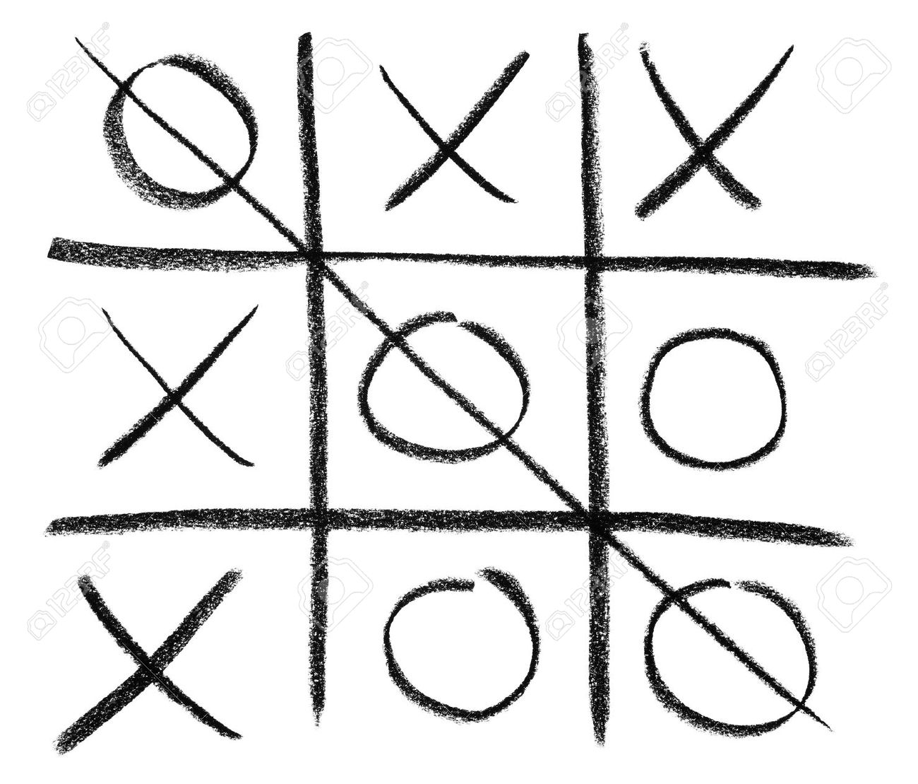

Slide 52
Features
User account
User can login with ID and password.
User data like status and achievements is persistent via DB.
Real-time game between users
Turn game with turn-timeout
Finding an opponent with matchmaker.
When no opponent, bot will play with an user.

Slide 53
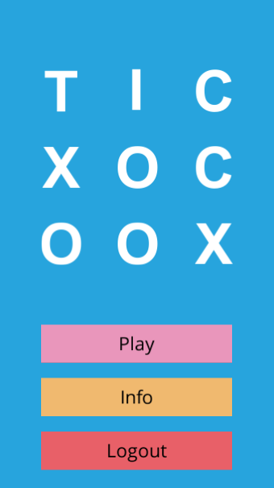
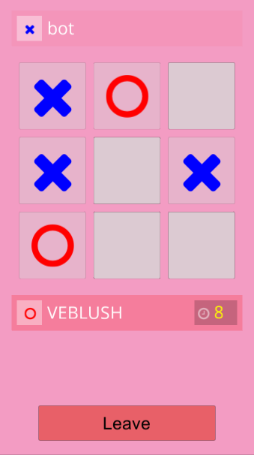
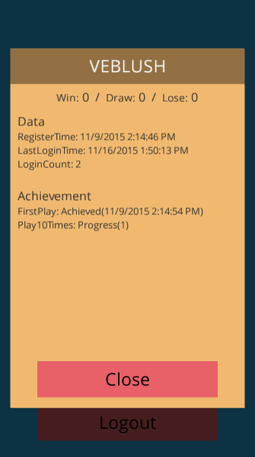
https://github.com/SaladLab/TicTacToe

Slide 54
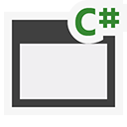
Project structure
Domain
450 cloc
Domain.Tests
GameServer
965 cloc
GameServer.Tests
GameClient
1141 cloc

Slide 55
Cluster node structure
Master
User
Game
User
Game
GamePairMaker
User
Game
User
Game
User
Table
User
Login
GameBot
GameBot
Game
Table

Slide 56
Actor structure
User
Login
MongoDB
Client
Client
Session
User
GamePairMaker
Game
GameBot

Slide 57
Main tasks
Login
Match Making
Join
Game
Game Play
Finish Game

Slide 58
Login
LoginActor will
Be a first actor which client can access.
Authenticate user with ID and password.
Create an user actor and bind it with client.
Client can communicate with only bound actors.
Only through bound interfaced even for bound actors.

Slide 59
Login: Actor
User
Login
MongoDB
Login
Create
Client
Client
Session
User
Bind

Slide 60
Login: Code
Client
Server
// client requests login to server
var t1 = login.Login(id, password, observerId);
yield return t1.WaitHandle;
// check account, create user actor and bind it to client
async Task<LoginResult> IUserLogin.Login(id, password) {
var userId = CheckAccount(id, password);
var user = CreateUserActor(userId);
await UserTable.AddUserAsync(userId, user);
var bindId = await ClientSession.BindAsync(user, typeof(IUser));
// client gets user actor
var user = new UserRef(t1.Result);

Slide 61
Matchmaking
Behavior
Client sends a request to a pair-maker and waits for 5 secs.
A pair-maker enqueues a request.
When there are 2 users on queue, make them a pair.
When timeout, a bot is created and make a pair.

Slide 62
Matchmaking: Actor
Client
Client
Session
User
Register
GamePairMaker
Created
Create
Game

Slide 63
Matchmaking: Code
// client requests pairing from UserActor
yield return G.User.RegisterPairing(observerId).WaitHandle;
// UserActor forwards a request to GamePairMakerActor
class GamePairMakerActor : ... {
void RegisterPairing(userId, userName, ...) {
AddToQueue(userId);
}
void OnSchedule() {
if (Queue.Count >= 2) {
user0, user1 = Queue.Pop(2);
CreateNewGame();
user0.SendNoticeToUser(gameId);
user1.SendNoticeToUser(gameId);

Slide 64
Join game
Behavior
GameRoom actor will be created for every games.
User gets an ActorRef to GameRoom from a pair-maker.
User enters GameRoom and starts playing.
On entering user registers GameObserver to listen game events.

Slide 65
Join game: Actor
Client
Client
Session
Join
User
Join
Bind
Game

Slide 66
Join game: Code
// client sends a join request to UserActor.
var ret = G.User.JoinGame(roomId, observerId);
yield return ret.WaitHandle;
// UserActor forwards a request to GameActor.
// when done, grant GameActor to Client as IGamePlayer.
class UserActor : ... {
async Task<...> IUser.JoinGame(long gameId, int observerId) {
var game = await GameTable.GetAsync(gameId);
await game.Join(...);
var bindId = await BindAsync(game.Actor, typeof(IGamePlayer));
return ...;
}

Slide 67
Game play
Behavior
Client plays game with an ActorRef to GameRoom.
Client gets game events like opponent’s turn and result of game from a GameObserver registered to GameRoom.

Slide 68
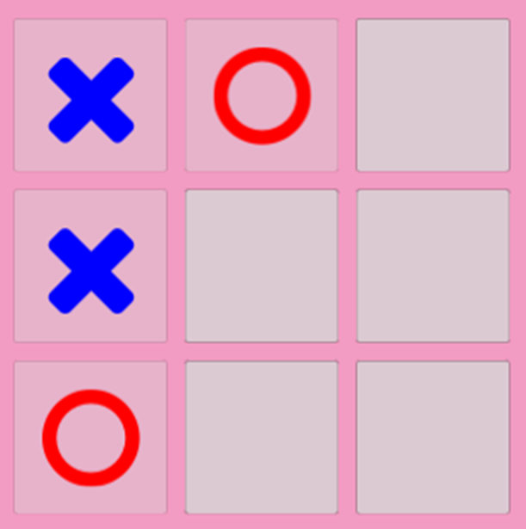
Game play: Command: Actor
MakeMove
Client
Client
Session
Game
GameRef.MakeMove(2,1)

Slide 69
Game play: Command: Code
// client sends a move command to GameActor
class GameScene : MonoBehavior, IGameObserver {
void OnBoardGridClicked(int x, int y) {
_myPlayer.MakeMove(new PlacePosition(x, y));
}
// GameActor proceeds the game by command
public class GameActor : ... {
void MakeMove(PlacePosition pos, long playerUserId) {
DoGameLogic();
...
}

Slide 70
Game play: Game events: Actor
MakeMove
Game
Client
Client
Session
MakeMove
GameObserver.MakeMove(2,1)

Slide 71
Game play: Game events: Code
// GameActor broadcasts game events to clients
public class GameActor : ... {
void MakeMove(PlacePosition pos, long playerUserId) {
...
NotifyToAllObservers((id, o) => o.MakeMove(...));
}
// client consumes game events
class GameScene : MonoBehavior, IGameObserver {
void IGameObserver.MakeMove(...) {
Board.SetMark(...);
}

Slide 72
Finish game
Behavior
Game room reports on the end of game to user actor.
User actor updates user’s status and achievements and propagates changes to client and DB.
Destroy a game room actor.

Slide 73
Finish game: Actor
MongoDB
Update
Update
Client
Client
Session
User
End
End
Game
Kill

Slide 74
Finish game: Code
// UpdateActor updates user state when the game is over
void IGameUserObserver.End(long gameId, GameResult result) {
_userContext.Data.GameCount += 1;
// flush changes to client and storage
_userEventObserver.UserContextChange(_userContext.Tracker);
MongoDbMapper.SaveAsync(_userContext.Tracker, _id);
_userContext.Tracker = new TrackableUserContextTracker();
}
// when no one left in GameActor, kill actor
void Leave(long userId) {
NotifyToAllObservers((id, o) => o.Leave(playerId));
if (_players.Count() == 0) {
Self.Tell(InterfacedPoisonPill.Instance);

Slide 75
Conclusion

Slide 76
Akka.NET
Good to go
Akka.NET is a handy building block.
Akka.Interfaced.SlimSocket allows an Unity3D client to interact with an interfaced actor.
Keep in mind that it is still young
Quite stable to use.
But it is quite early to say “matured”.
When something goes wrong, it is necessary to check not only your code but also library code. ☺

Slide 77
Try it
Tic-tac-toe
Grab sources and run it
https://github.com/SaladLab/TicTacToe
Libraries
Visit project Github pages
Get libraries from NuGet and Github Releases

Slide 78
Thank you

